Slide 1
Data Visualisation on UK Bank customer data using Tableau dashboards
Presentation by :- Parth Tiwari

Slide 2

Agenda
Introduction
Data Sources
data preprocessing
Creating worksheets
Interactive Dashboard
Story

Slide 3
Data sources
The data is collected from multiple data sources-
One dataset collected from Kaggle consists of 4,014 rows including the attributes of Customer ID, Name, Surname, Gender, Age, Region, Job Classification, Date Joined, and Balance
Another dataset is generated on mockaroo for customer credit-card eligibility which includes Customer account number, Credit score of customers and Eligibility status.
Notes:
You can blame this guy.
This is Robert McKim. He was an engineering professor at Stanford in the 1960s and helped found the Stanford Design School. His research focused on creativity and how to foster it. He would do this same art project with his students, at the beginning of each semester.
Outside of art projects for adults, one of the main takeaways from his research was quite simple and profound. Adults on the whole, are embarrassed to share ideas with peers. But clearly, we’re not born this way. Our apprehension builds over time.
As adults we've grown uncomfortable with sharing things early and often. Today we are going to try and break down that barrier. One of the things we often hear from customers is that I’ve got this Excel workbook and I need to recreate the same thing in Tableau. Sometimes we don’t need to reinvent the wheel but more times than not we don’t challenge ourselves out of the current status. The purpose of this workshop is to focus on 5 specific areas to help break down the barrier to allow us to think in a more open and creative way.

Slide 4
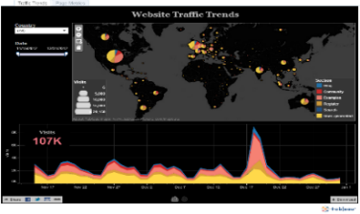
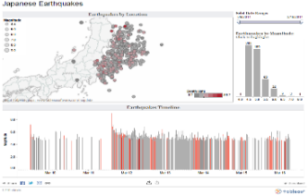
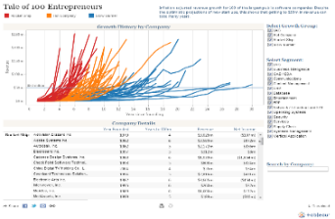
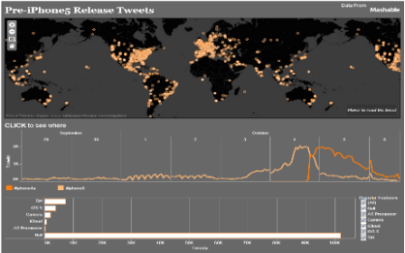
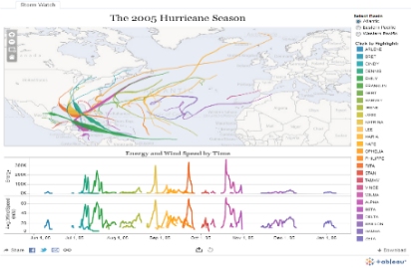
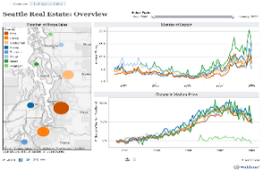
Visualization
Created an Interactive dashboard with Tableau to help uncover the story buried in the data. It is a powerful piece of software used to create interactive dashboards that aid in both data analysis and uncovering the narrative concealed within the data. It has an intuitive drag-and-drop interface, making the creation of imaginative dashboards quite quick.
Notes:
We are going to do 1 more quick exercise. Everyone was asked to bring a dashboard that is either complete or close to complete. Take your pen and paper and write down the question(s) your dashboard is trying to answer.
We maybe referring back to these questions throughout the workshop and challenging you if your content is answering your intended questions or new questions.
This is really important…many times we throw the kitchen sink and try to solve 100 problems in one dashboard. We need to take a minute and reflect on the problem we are trying to solve.

Slide 5
Data pre-process
I divided each region into the four regions of England, Northern Ireland, Scotland, and Wales for the purposes of a regional comparison.
The filter for other attributes will be these areas.
There are four regions in the entire data set.
The filter is based on the map's four regions.
the data's distribution by gender, age, and job category.
Notes:
Comparison charts are designed to set one variable apart from another
These charts also display how the two variables interact with each other.
They can compare items or one another or show differences over time.

Slide 6
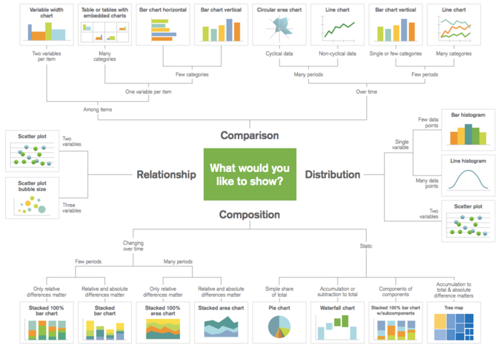
Do I have the right chart?
Notes:
A common mistake that I hear many people make is that they choose the chart type that they want. For example, declaring that they want a bar chart or a line graph vs spending time exploring their data, understanding the story they want to tell, and choosing a chart type that supports their analysis.
Take a look at the charts on your dashboard.. What are you trying to do?
Comparison – are you comparing one or more variable?
Relationship – are you showing a connection or correlation between two or more variables?
Composition – are you showing a change over time and/or parts to a whole?
Distribution – are you attempting to identify outliers and trends?
We are going to take the next few minutes to review some common chart types and explore if they are trying to answer the intended question.
Additional resources:
https://public.tableau.com/profile/josh.weyburne#!/vizhome/CookBook/VizCookbook
https://public.tableau.com/en-us/gallery/visual-vocabulary
https://public.tableau.com/views/TheTableauChartCatalog/TableauChartExamples?:embed=y&:display_count=yes&:origin=viz_share_link&:showVizHome=no#1
https://public.tableau.com/profile/bbc.audiences#!/vizhome/BBCAudiencesTableauStyleGuide/MoreInfo2
Call to action: ensure every participant has their own Tableau Public site and is subscribed to the viz of the day as we review the above resources. Invite people to follow along and bookmark these links.

Slide 7
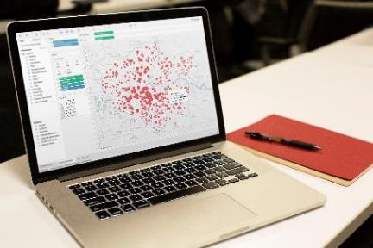
What makes a good dashboard?
Answers a set of questions
Follows a flow and invites interactivity
Condensed; primarily in the form of summaries and exceptions
Specific to and customized for the dashboard’s audience and objectives
Provides appropriate text for clarity and direction, if needed
Makes strategic use of color
Notes:
When it comes to visual best practices, there aren’t any hard and fast rules, such as “do this and never do that.” It isn’t a black and white process. There are, however, guidelines that make sense most of the time. Many of these derive from studies done on how we as humans process things like color, shape, and size. When you really understand the concepts driving these guidelines, only then should you break them.

Slide 8
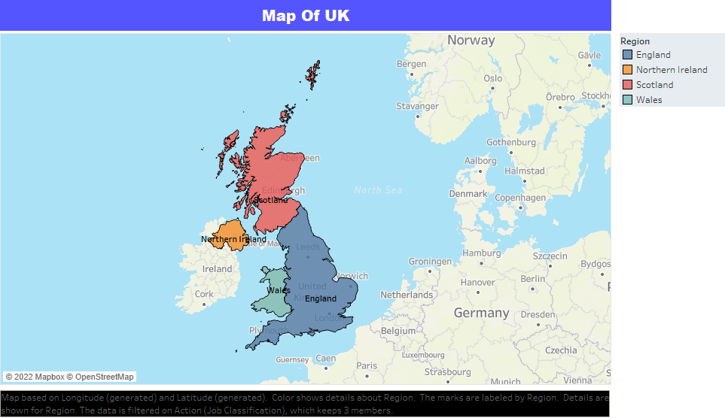
Geographical area of United Kingdom
By reorganizing the data to represent the regions' precise locations on the world map, the UK customer map was produced.
Notes:
Composition charts are used to display parts of a whole and change over time.
Pie charts callout: friends don’t let friends use pie charts (or 3D charts)… but if you must, use when comparing no more than 3 variables at a time.
Audience participation opportunity: why don’t we love pie or 3D charts when performing visual analysis?
Answer: We are not as good at noticing area and angle, and those just so happen to be the two main aspects of a pie chart. (swag opportunity for participant)
https://interworks.com/blog/rcurtis/2018/01/19/friends-dont-let-friends-make-pie-charts/

Slide 9
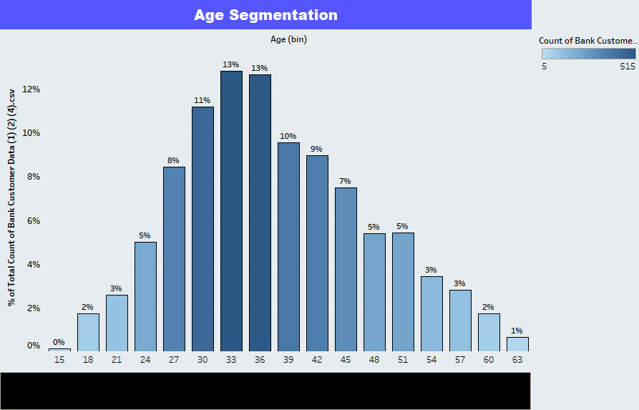
Age Segmentation
I made a chart to show how the percentage of clients is distributed throughout the various age groups. To make a dashboard that is interactive, I included filters.
Notes:
Composition charts are used to display parts of a whole and change over time.
Pie charts callout: friends don’t let friends use pie charts (or 3D charts)… but if you must, use when comparing no more than 3 variables at a time.
Audience participation opportunity: why don’t we love pie or 3D charts when performing visual analysis?
Answer: We are not as good at noticing area and angle, and those just so happen to be the two main aspects of a pie chart. (swag opportunity for participant)
https://interworks.com/blog/rcurtis/2018/01/19/friends-dont-let-friends-make-pie-charts/

Slide 10
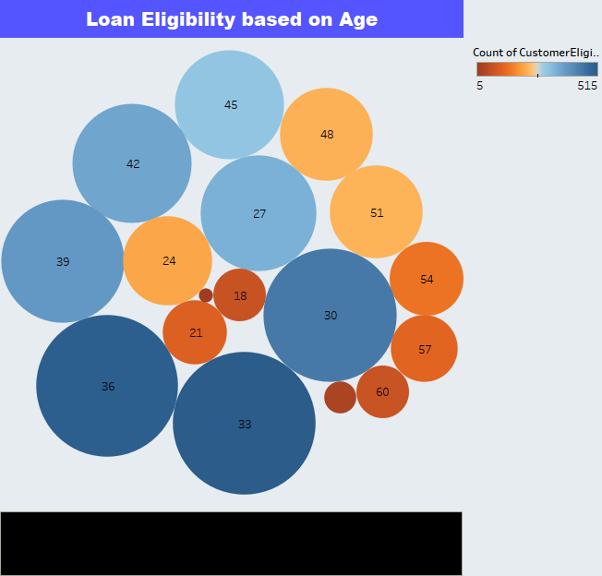
Loan Eligibility based on Age
Notes:
Composition charts are used to display parts of a whole and change over time.
Pie charts callout: friends don’t let friends use pie charts (or 3D charts)… but if you must, use when comparing no more than 3 variables at a time.
Audience participation opportunity: why don’t we love pie or 3D charts when performing visual analysis?
Answer: We are not as good at noticing area and angle, and those just so happen to be the two main aspects of a pie chart. (swag opportunity for participant)
https://interworks.com/blog/rcurtis/2018/01/19/friends-dont-let-friends-make-pie-charts/

Slide 11
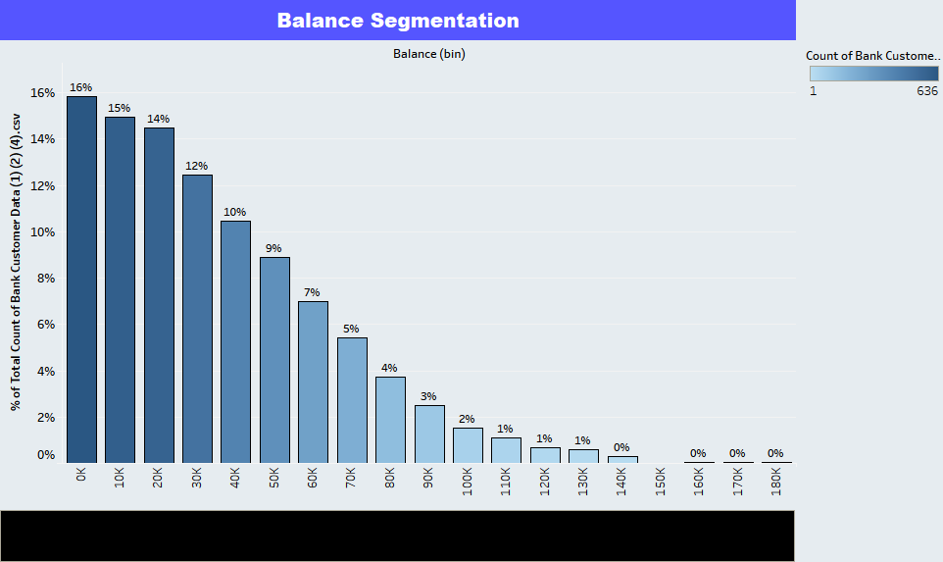
Balance Segmentation
I made a chart that shows the percentage of clients that have a certain amount of money in their bank accounts. You can use this graph to see how balances are distributed among the dashboard's various regions.
Notes:
Composition charts are used to display parts of a whole and change over time.
Pie charts callout: friends don’t let friends use pie charts (or 3D charts)… but if you must, use when comparing no more than 3 variables at a time.
Audience participation opportunity: why don’t we love pie or 3D charts when performing visual analysis?
Answer: We are not as good at noticing area and angle, and those just so happen to be the two main aspects of a pie chart. (swag opportunity for participant)
https://interworks.com/blog/rcurtis/2018/01/19/friends-dont-let-friends-make-pie-charts/

Slide 12
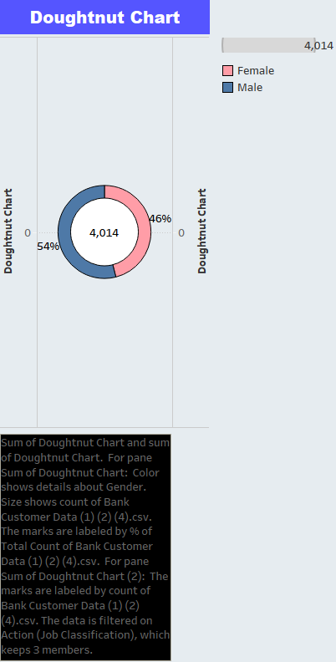
Donut Chart
This pie chart displays the gender to study the various demographics in each region.
Notes:
Composition charts are used to display parts of a whole and change over time.
Pie charts callout: friends don’t let friends use pie charts (or 3D charts)… but if you must, use when comparing no more than 3 variables at a time.
Audience participation opportunity: why don’t we love pie or 3D charts when performing visual analysis?
Answer: We are not as good at noticing area and angle, and those just so happen to be the two main aspects of a pie chart. (swag opportunity for participant)
https://interworks.com/blog/rcurtis/2018/01/19/friends-dont-let-friends-make-pie-charts/

Slide 13
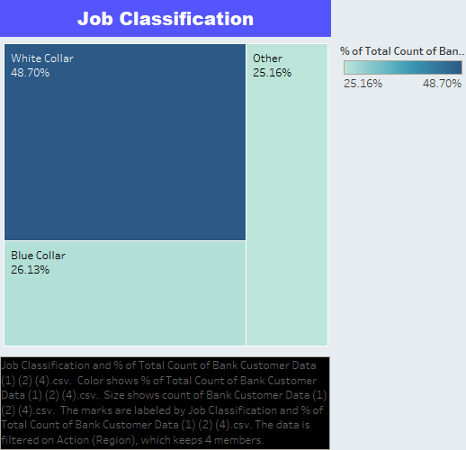
job classifications
Created a tree graph that illustrates the banks job classifications for each customer. Once this is in the dashboard you can analyze the changes in job classification per region
Notes:
Composition charts are used to display parts of a whole and change over time.
Pie charts callout: friends don’t let friends use pie charts (or 3D charts)… but if you must, use when comparing no more than 3 variables at a time.
Audience participation opportunity: why don’t we love pie or 3D charts when performing visual analysis?
Answer: We are not as good at noticing area and angle, and those just so happen to be the two main aspects of a pie chart. (swag opportunity for participant)
https://interworks.com/blog/rcurtis/2018/01/19/friends-dont-let-friends-make-pie-charts/

Slide 14
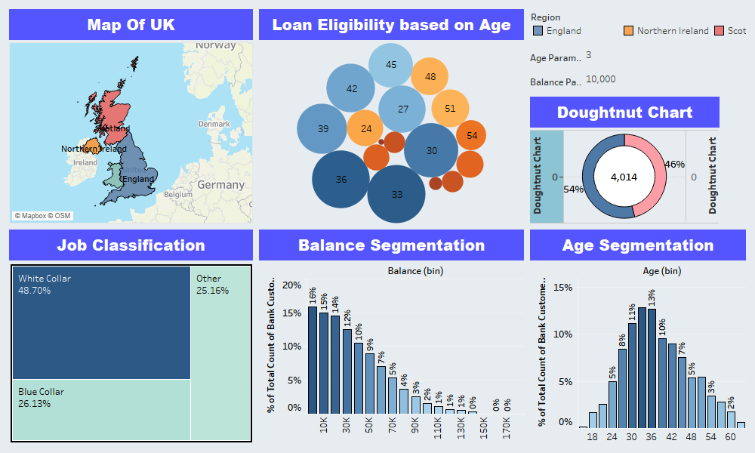
Dashboard
Notes:
Composition charts are used to display parts of a whole and change over time.
Pie charts callout: friends don’t let friends use pie charts (or 3D charts)… but if you must, use when comparing no more than 3 variables at a time.
Audience participation opportunity: why don’t we love pie or 3D charts when performing visual analysis?
Answer: We are not as good at noticing area and angle, and those just so happen to be the two main aspects of a pie chart. (swag opportunity for participant)
https://interworks.com/blog/rcurtis/2018/01/19/friends-dont-let-friends-make-pie-charts/

Slide 15
Story
Notes:
Distribution charts are used to show how variables are distributed over time, helping identify outliers and trends.

Slide 16
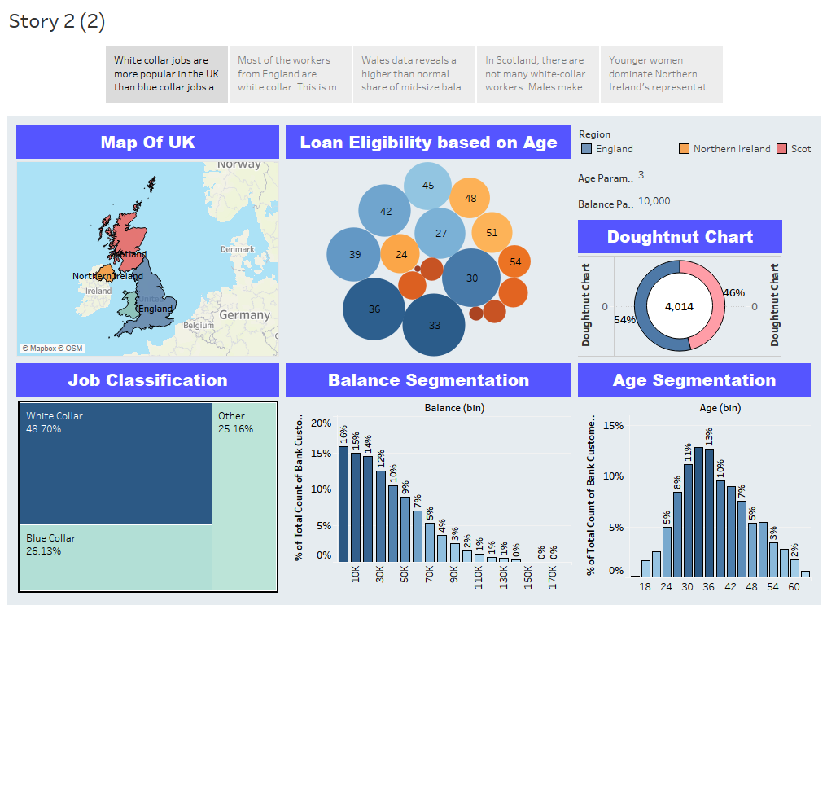
Story -
Notes:
Composition charts are used to display parts of a whole and change over time.
Pie charts callout: friends don’t let friends use pie charts (or 3D charts)… but if you must, use when comparing no more than 3 variables at a time.
Audience participation opportunity: why don’t we love pie or 3D charts when performing visual analysis?
Answer: We are not as good at noticing area and angle, and those just so happen to be the two main aspects of a pie chart. (swag opportunity for participant)
https://interworks.com/blog/rcurtis/2018/01/19/friends-dont-let-friends-make-pie-charts/

Slide 17
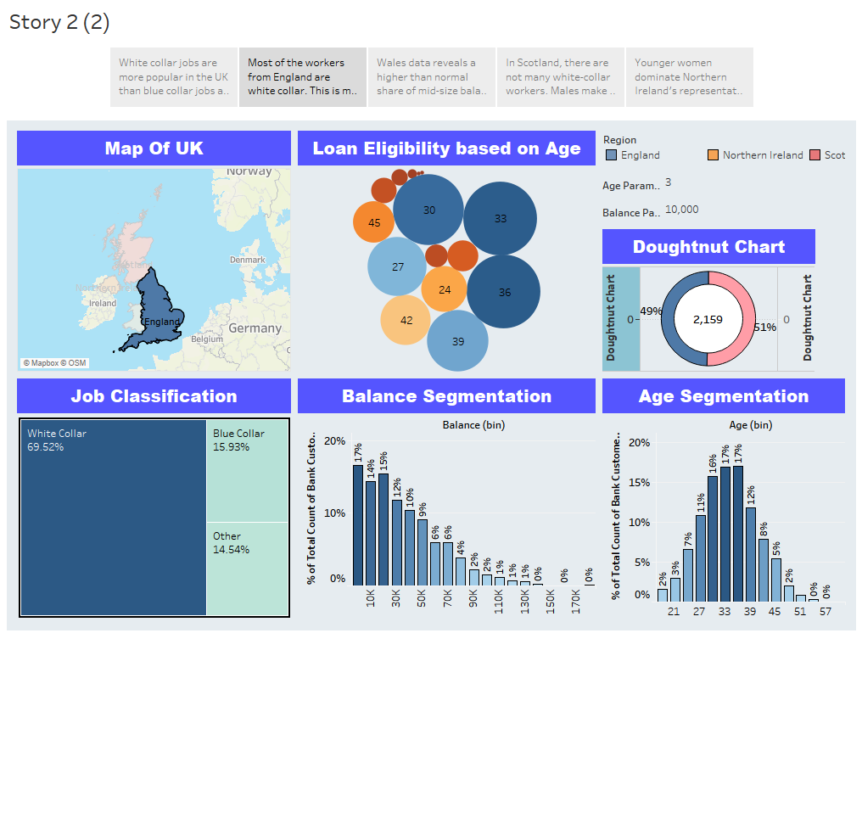
Story- Most of the workers from England are white collar. This is most likely a result of London serving as Europe's financial center. The gender ratio is also nearly equal.
Notes:
Composition charts are used to display parts of a whole and change over time.
Pie charts callout: friends don’t let friends use pie charts (or 3D charts)… but if you must, use when comparing no more than 3 variables at a time.
Audience participation opportunity: why don’t we love pie or 3D charts when performing visual analysis?
Answer: We are not as good at noticing area and angle, and those just so happen to be the two main aspects of a pie chart. (swag opportunity for participant)
https://interworks.com/blog/rcurtis/2018/01/19/friends-dont-let-friends-make-pie-charts/

Slide 18
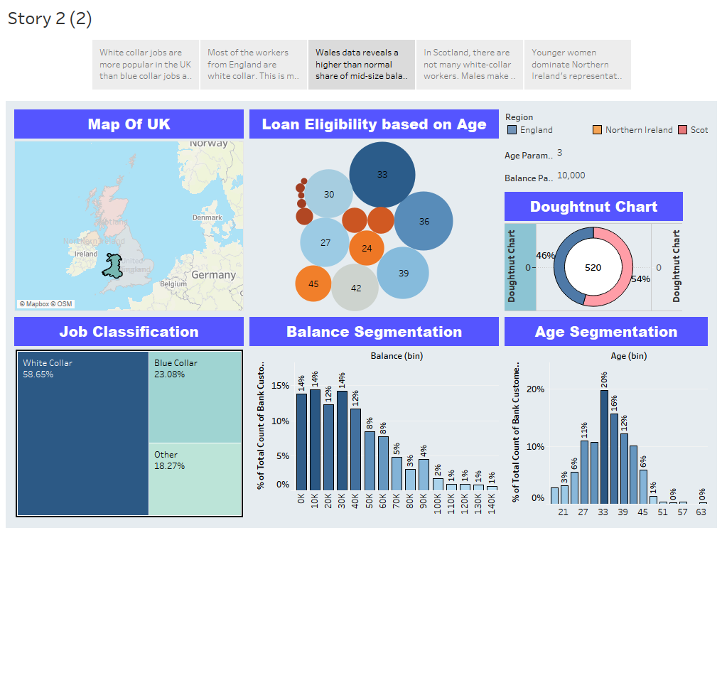
Story -Wales data reveals a higher than normal share of mid-size balances. People who are 33 to 35 years old are highly eligible for loans. This is so because people at this age are young and prosperous and have good credit score.
Notes:
Composition charts are used to display parts of a whole and change over time.
Pie charts callout: friends don’t let friends use pie charts (or 3D charts)… but if you must, use when comparing no more than 3 variables at a time.
Audience participation opportunity: why don’t we love pie or 3D charts when performing visual analysis?
Answer: We are not as good at noticing area and angle, and those just so happen to be the two main aspects of a pie chart. (swag opportunity for participant)
https://interworks.com/blog/rcurtis/2018/01/19/friends-dont-let-friends-make-pie-charts/

Slide 19
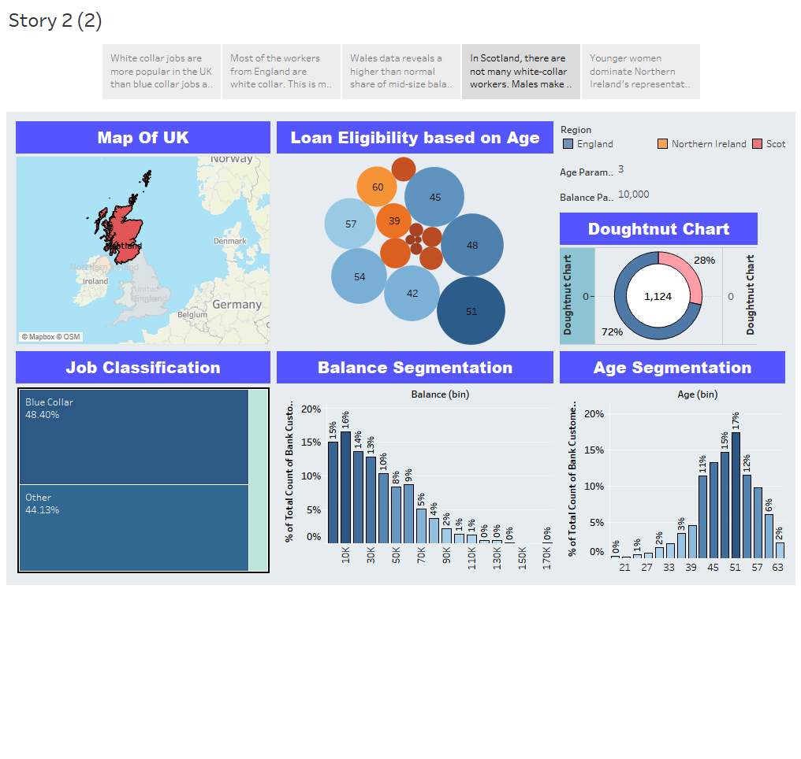
Story -In Scotland, there are not many white-collar workers. Males make up about 72% of the customer base.
Notes:
Composition charts are used to display parts of a whole and change over time.
Pie charts callout: friends don’t let friends use pie charts (or 3D charts)… but if you must, use when comparing no more than 3 variables at a time.
Audience participation opportunity: why don’t we love pie or 3D charts when performing visual analysis?
Answer: We are not as good at noticing area and angle, and those just so happen to be the two main aspects of a pie chart. (swag opportunity for participant)
https://interworks.com/blog/rcurtis/2018/01/19/friends-dont-let-friends-make-pie-charts/

Slide 20
Story -In Scotland, there are not many white-collar workers. Males make up about 72% of the customer base.
Notes:
Composition charts are used to display parts of a whole and change over time.
Pie charts callout: friends don’t let friends use pie charts (or 3D charts)… but if you must, use when comparing no more than 3 variables at a time.
Audience participation opportunity: why don’t we love pie or 3D charts when performing visual analysis?
Answer: We are not as good at noticing area and angle, and those just so happen to be the two main aspects of a pie chart. (swag opportunity for participant)
https://interworks.com/blog/rcurtis/2018/01/19/friends-dont-let-friends-make-pie-charts/

Slide 21
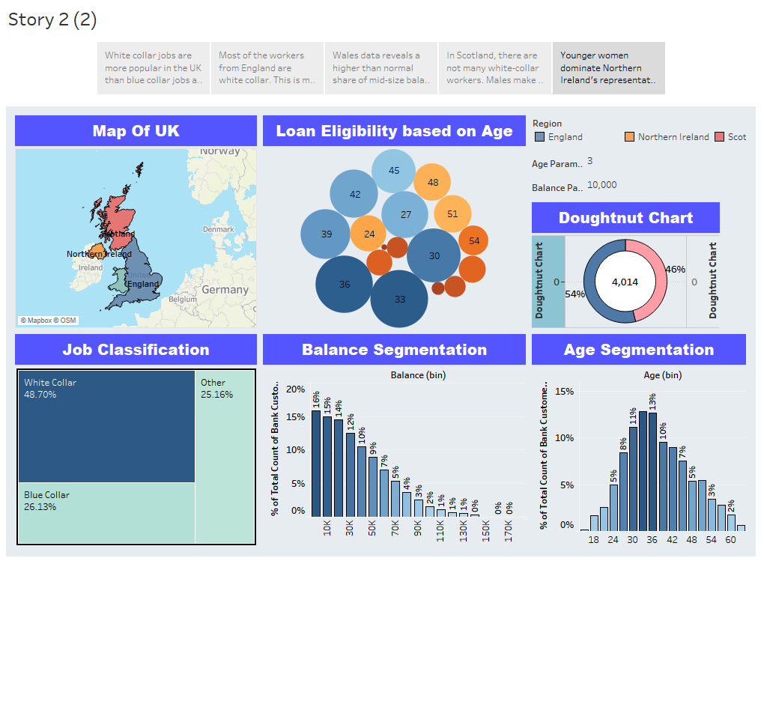
Story- Younger women dominate Northern Ireland's representation, and young people have a greater chance of readily qualifying for a loan.
Notes:
Composition charts are used to display parts of a whole and change over time.
Pie charts callout: friends don’t let friends use pie charts (or 3D charts)… but if you must, use when comparing no more than 3 variables at a time.
Audience participation opportunity: why don’t we love pie or 3D charts when performing visual analysis?
Answer: We are not as good at noticing area and angle, and those just so happen to be the two main aspects of a pie chart. (swag opportunity for participant)
https://interworks.com/blog/rcurtis/2018/01/19/friends-dont-let-friends-make-pie-charts/

Slide 22
Github Repository
https://github.com/parth0309/Data-Visualization-project-Parth-Tiwari.git

Slide 23
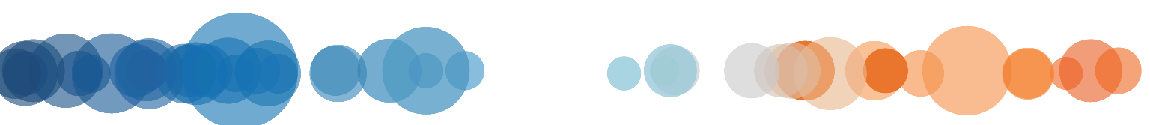
THANK YOU!
Notes:
Full Page Image w Color Bar

